Slide 1
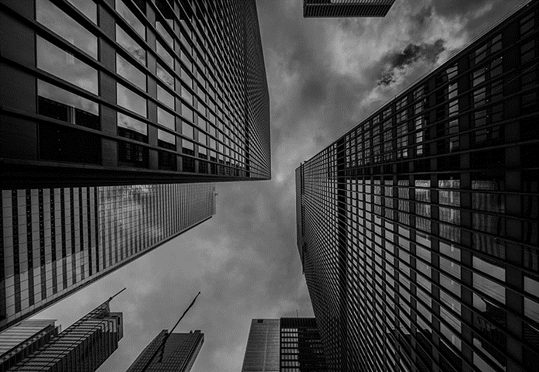

The art of data annotation
OPTIMISED MACHINE LEARNING

Slide 2
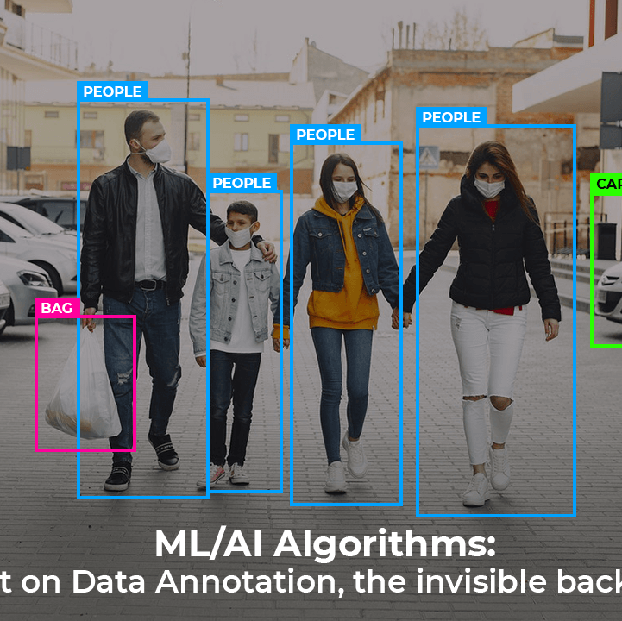
WHAT IS DATA ANNOTATION?
Data annotation is the categorization and labelling of data for AI applications.
With high-quality, human-powered data annotation, companies can build and improve AI implementations.
The result is an enhanced customer experience solution such as product recommendations, relevant search engine results, computer vision, speech recognition, chatbots, and more.
Notes:
This data can be in the form of images, text, audio, or video, . This data annotation can be done manually by a human or automatically using advanced machine learning algorithms and tools.

Slide 3
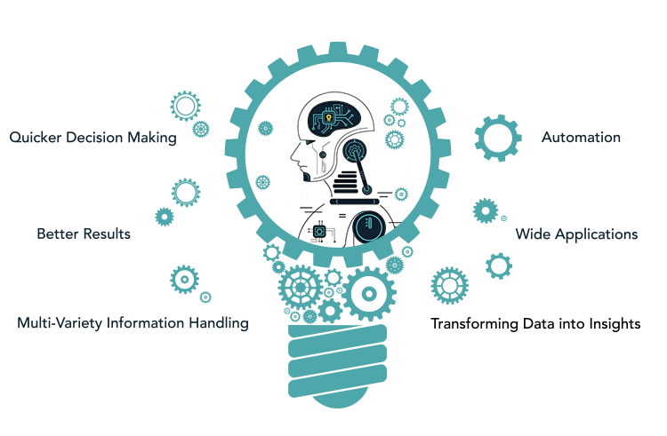
WHY IS IT IMPORTANT?
Businesses are adopting AI technology to automate decision-making and benefit from new business opportunities
Machine learning models have a wide variety of critical applications (e.g., healthcare) where erroneous AI/ML models can be dangerous
Finding high-quality annotated data is one of the primary challenges of building accurate machine-learning models

Slide 4
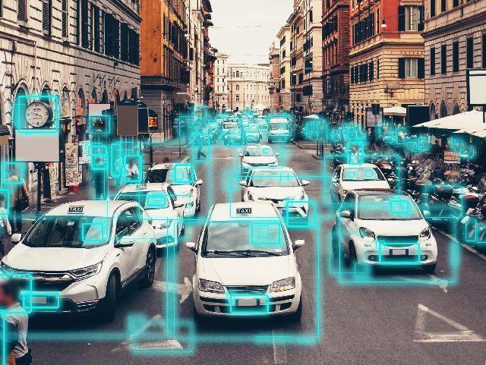
HOW EASY OR DIFFICULT IS IT?
Data annotation is especially important when considering the amount of unstructured data that exists in the form of text, images, video, and audio. By most estimates, unstructured data accounts for 80% of all data generated.

Slide 5
TYPES OF DATA ANNOTATIONS
Medical data annotation: Medical data annotation is used to annotate data such as medical images (MRI scans), and clinical notes, etc. This type of data annotation helps develop computer vision-enabled systems for disease diagnosis and automated medical data analysis.
Retail data annotation: Retail data annotation is used to annotate retail data such as product images, customer data, and sentiment data. Automotive data annotation: This industry-specific annotation is used to annotate data from autonomous vehicles, such as data from cameras and lidar sensors. This annotation type helps develop models that can detect objects in the environment and other data points for autonomous vehicle systems.
Industrial data annotation: Industrial data annotation is used to annotate data from industrial applications, such as manufacturing images, maintenance data, safety data, quality control, etc

Slide 6
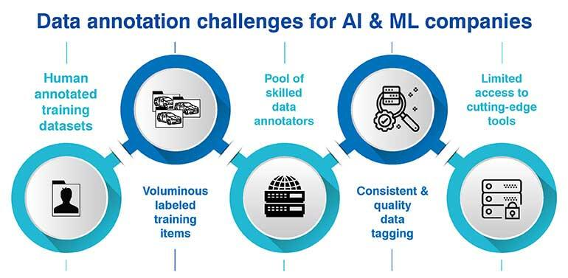
USE OF DATA ANNOTATION
For example, in a supervised learning problem of email spam classification, the algorithm would be trained using a labelled dataset where each email is labelled as "spam" or "not spam." The algorithm would learn the characteristics of spam emails and use that knowledge to classify new, unseen emails as either spam or not spam.

Slide 7
CATEGORIES OF PROBLEMS
The problem solved by supervised machine learning model can be viewed in two broad categories:
Classification: Assigning test data into specific categories. For instance, predicting whether a patient has a disease and assigning their health data to “disease” or “no disease” categories is a classification problem.
Regression: Establishing a relationship between dependent and independent variables. Estimating the relationship between the budget for advertising and the sales of a product is an example of a regression problem.

Slide 8
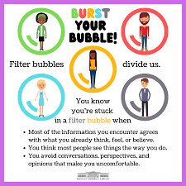
THREAT POSED BY AI
The bubble effect :
The emergence of social media has introduced algorithms that tailor content to match our interests. While this creates a personalized experience, it also creates a "bubble" of similarity or confirmation bias, reinforcing our existing beliefs and filtering out opposing viewpoints that challenge our perspectives
As humans, we’re highly susceptible to this bubble effect. And since AI relies on human input and intervention, there’s always a risk that personal bias “bubbles” filter through to data, despite genuine attempts at objectivity.
By understanding bias, the sources from which it originates, and the processes by which they infiltrate data, we can actively design systems to avoid, minimize, and – as much as is humanly and mechanically possible – eliminate them.

Slide 9
SOCIAL SURVEILLANCE WITH AI TECHNOLOGY
In addition to its more existential threat, Ford is focused on the way AI will adversely affect privacy and security. A prime example is China’s use of facial recognition technology in offices, schools and other venues. Besides tracking a person’s movements, the Chinese government may be able to gather enough data to monitor a person’s activities, relationships and political views.
Another example is U.S. police departments embracing predictive policing algorithms to anticipate where crimes will occur. The problem is that these algorithms are influenced by arrest rates, which disproportionately impact Black communities. Police departments then double down on these communities, leading to over-policing and questions over whether self-proclaimed democracies can resist turning AI into an authoritarian weapon.
“Authoritarian regimes use or are going to use it,” Ford said. “The question is, How much does it invade Western countries, democracies, and what constraints do we put on it?”

Slide 10
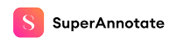
SUPER ANNOTATE TOOL
SuperAnnotate.com is a powerful cloud-based platform that
revolutionizes the process of image annotation and dataset
management for computer vision tasks. We will look at how this
platform has revolutionized the industry.

Slide 11
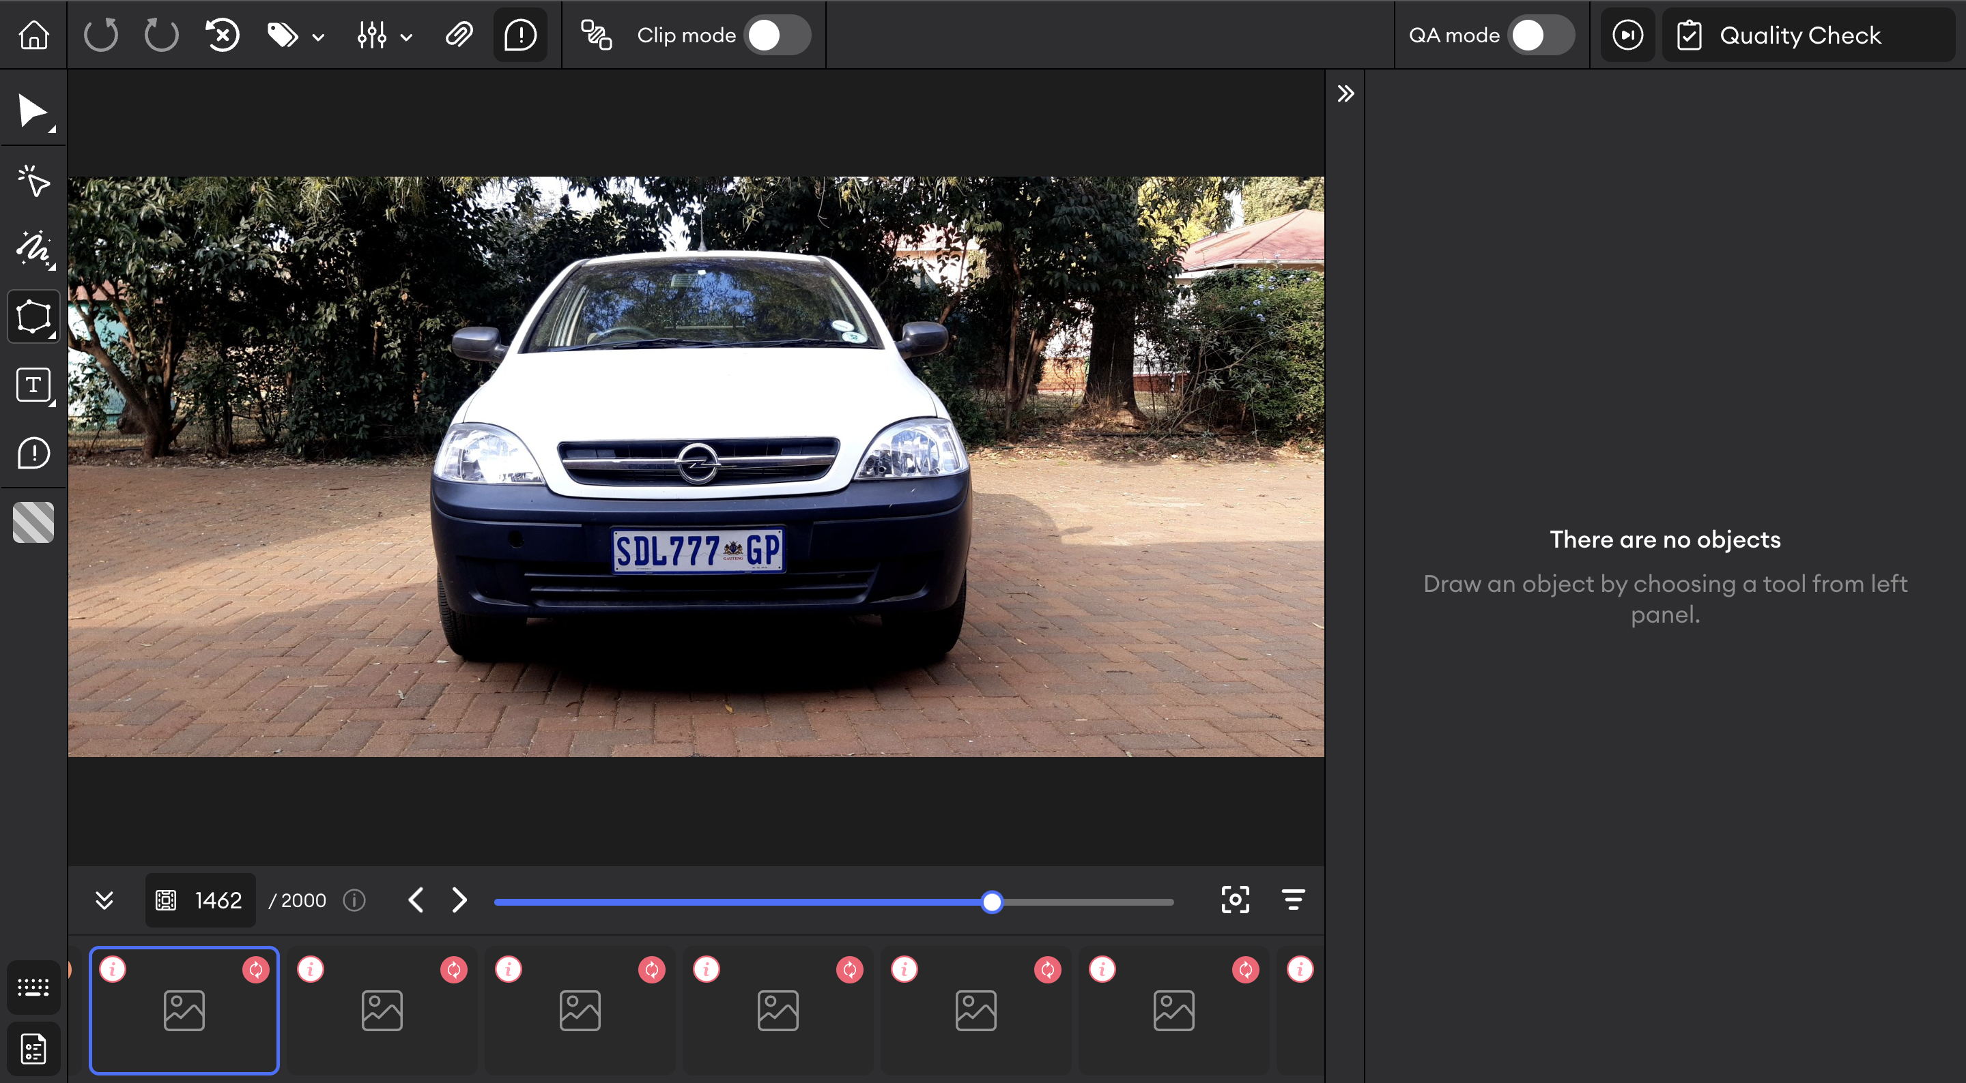
USAGE AND INTERFACE
Image Annotation Tools:
SuperAnnotate.com provides a wide range of annotation tools which include bounding boxes, polygons, points, lines, and more.
The platform’s annotation tools are intuitive and easy to use, allowing annotators to efficiently label datasets without extensive training or expertise.

Slide 12
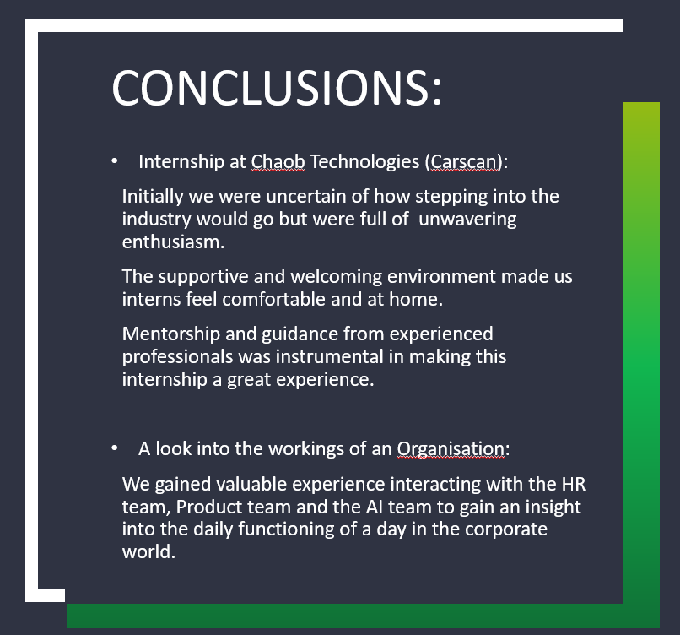
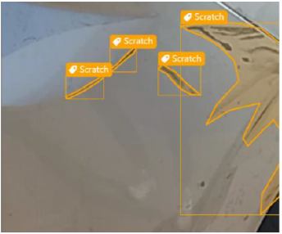
Using Machine Learning Techniques to reduce data annotation time
The review discusses different approaches that have been
proposed to tackle this challenge

Slide 13
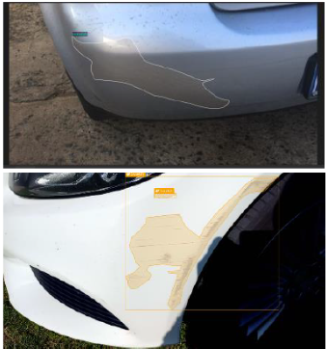
ACTIVE LEARNING
Algorithms aim to intelligently select the most informative samples from a large dataset for annotation
The review explores various active learning strategies, such as uncertainty sampling, query-by-committee, and information density-based approaches

Slide 14

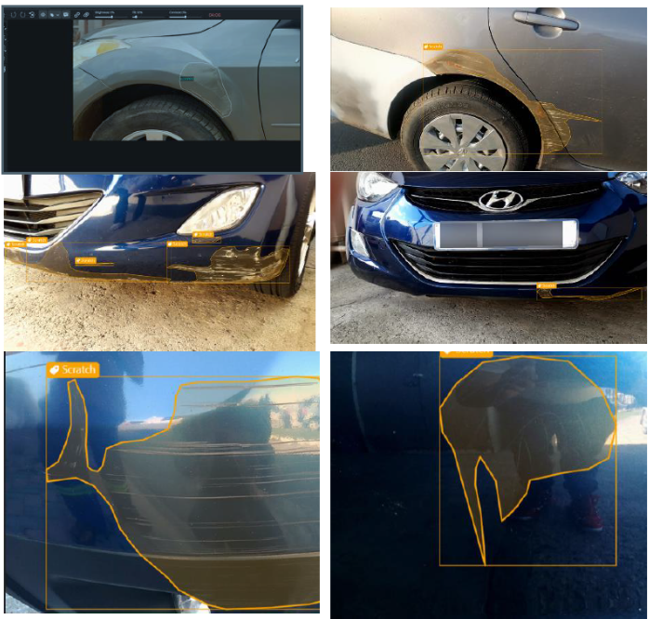
SEMI-SUPERVISED LEARNING
This approach leverages both labeled and unlabeled data to train models.
The review discusses techniques such as self-training, co-training, and multi-view learning.

Slide 15
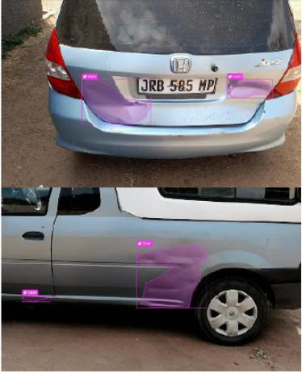
TRANSFER LEARNING
Transfer learning involves utilizing pre-trained models on large-scale datasets and fine-tuning them on a target task with limited annotated data
The literature review examines transfer learning Techniques, including domain adaptation and model adaptation

Slide 16
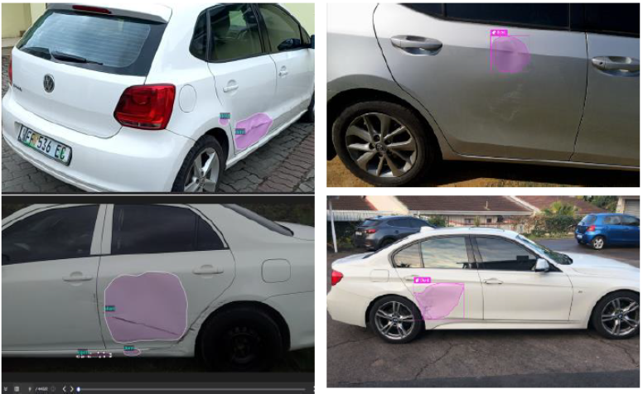
WEAKLY SUPERVISED LEARNING
This approach aims to train models with only partial or noisy annotations
The review explores techniques such as multiple instance learning, co-training with noisy labels

Slide 17

ASSIGNMENT 1 & ORIENTATION
a plan outlining how AI can be used to improve specific tech and product processes within the company.
To come up with practical and actionable ideas that can be implemented within the company’s existing framework.
Basic introduction and giving an idea of day-to-day operations of the company.
Asked to look out for two training sessions on products and services , scheduled in the next couple of days. This meeting ended with a brief QnA session.

Slide 18
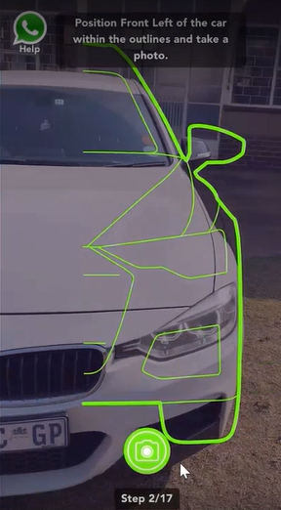
PRODUCT TRAINING
SESSION
We took a look at the different journeys and modes a user can use to avail company’s services. There are 3 different journeys:
WhatsApp
Web App
Mobile App
The sub-journeys were also classified into 3 again:
Inspection
Claim
360

Slide 19
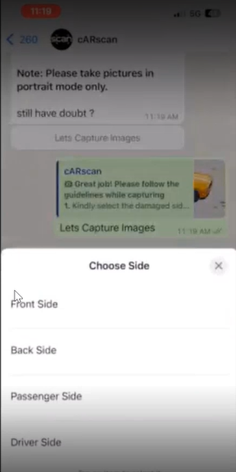
WHATSAPP JOURNEY
A link I triggered to the customer via WhatsApp to get a pop-up
Message:
Choose a damaged side of the car from the 4 given options which were:
Front
Back
Passenger
Driver

Slide 20
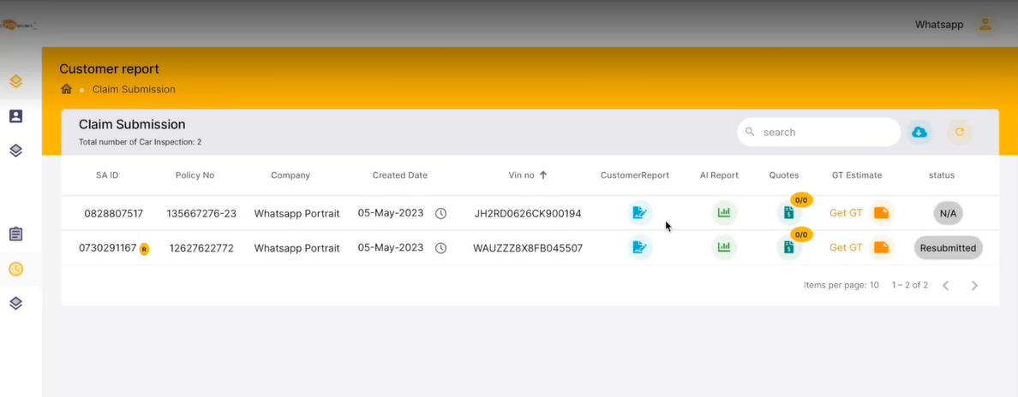
Title:
WHATSAPP JOURNEY
The claim is filed onto the dashboard.
A first AI report is initially and then later the final report is generated.

Slide 21
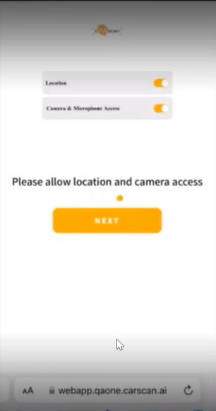

WEB APP JOURNEY
The app guides the user to click accurate pics of the car by providing a framework of the pic that is needed
An assessment summary is created to submit all your info and images as a part of the claim.

Slide 22
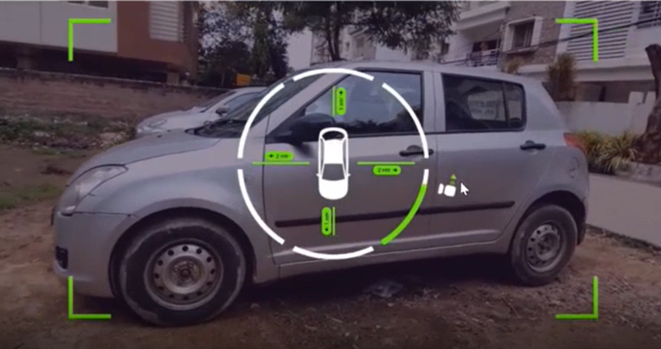
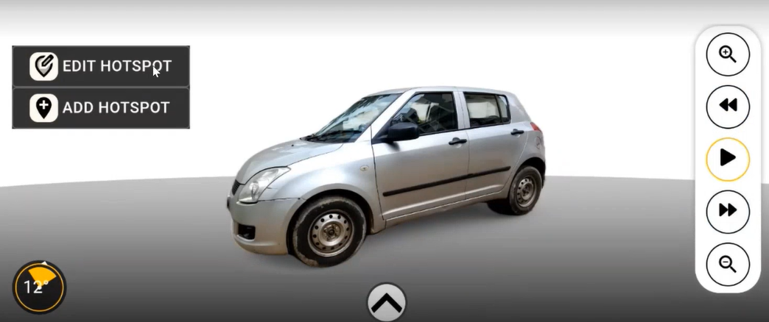
WEB APP JOURNEY
Exclusive to the webapp we also have the 360 journey
You will have to circle around the car to position the camera as asked by the app.
A 3d model of your car in 360 where you are allowed to annotate the hotspots

Slide 23
AI TRAINING SESSION
Very basics of AI and how it is being utilized to provide service,informed that 7 of us are going to be a part of the Data annotations team headed by Karthik Itharajulu
we would be transferred to the model training team after we have
had enough experience with our initial project

Slide 24
DATA ANNOTATION
In computer vision tasks, such as object detection, image classification, semantic segmentation, and instance segmentation, the process of data annotation involves labeling or tagging images or videos with relevant information to provide the ground truth for training algorithms.

Slide 25
The process of data annotation
Dataset Collection
Quality Control
Annotation Guidelines
Annotation Tools
Annotation Types

Slide 26
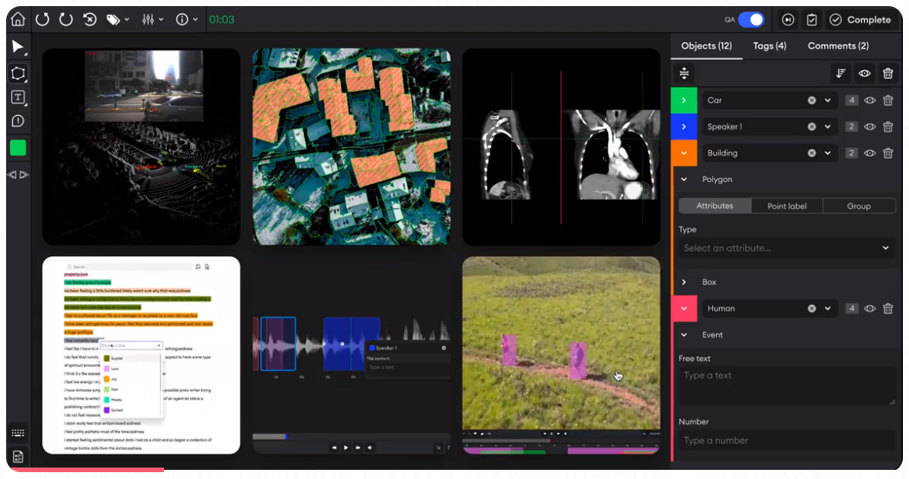
THE SUPER ANNOTATE INTERFACE

Slide 27
KEY FEATURES OF SUPER ANNOTATE
Versatile Annotation Types
Intuitive User Interface
Collaborative Environment
Auto-Annotation
Quality Assurance Mechanisms
Project Management Capabilities
Integration with Machine Learning Frameworks
Data Augmentation
Versatile Industry Applications
Image and Video Annotation

Slide 28
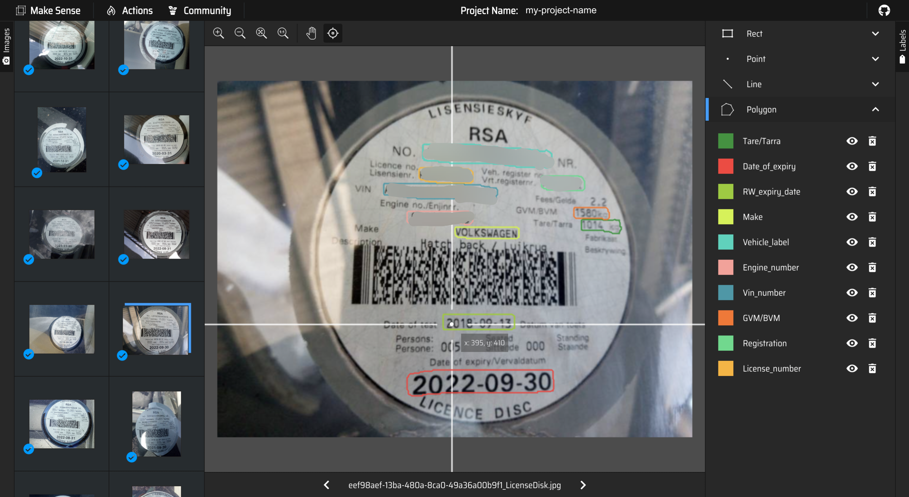
Annotation Using maksense.ai
The tool is particularly useful for small computer vision deep learning projects, as it simplifies and accelerates the process of dataset preparation. After labeling the photos, users can download the prepared labels in multiple supported formats.
It utilizes the SSD model pre-trained on the COCO dataset, which assists in drawing bounding boxes on photos and, in some cases, suggesting labels.

Slide 29
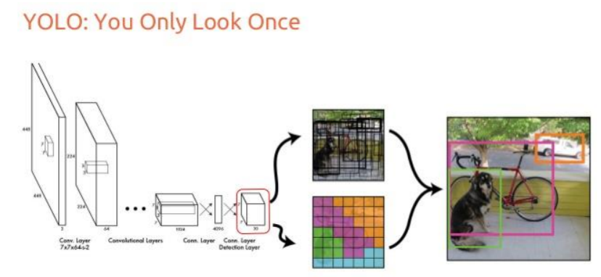
Optimising Object Notation with YOLOv5
YOLOv5 is a computer vision model for object detection and localization. It is the latest version of the YOLO (You Only Look Once) series of real-time object detection algorithms.
By running the train script provided by YOLOv5, we could train our object detection model for a 3k image dataset with all the annotation coordinates in cocojson format.
Notes:
This data can be in the form of images, text, audio, or video, . This data annotation can be done manually by a human or automatically using advanced machine learning algorithms and tools.

Slide 30
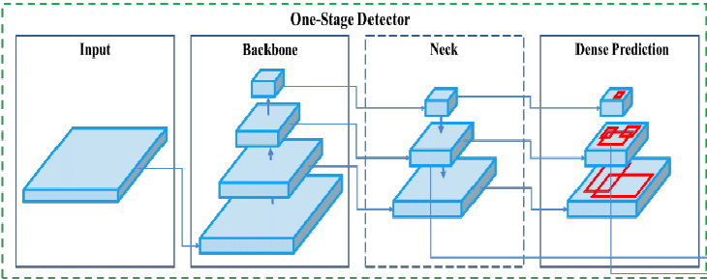
HIGH LEVEL ARCHITECTURE OF YOLOV
YOLO is a single-stage object detector architecture that is comprised of three main components: A backbone, a Neck, and a Head to make dense predictions
Model Backbone: The backbone refers to a pre-trained network employed to extract high-quality feature representations from images.
Model Neck: The model neck is responsible for extracting feature pyramids, enabling the model to effectively handle objects of varying sizes and scales.
Model head: executes the final operations, which involve applying anchor boxes to feature maps and generating the ultimate output. This output includes classes, objectness scores, and bounding boxes.

Slide 31
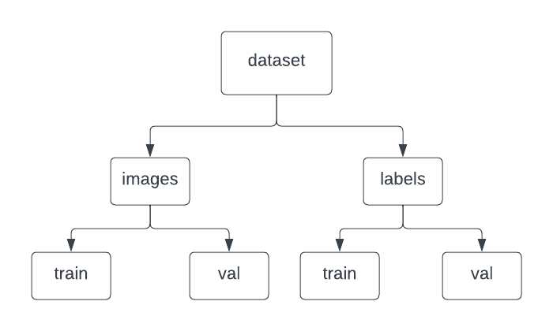
Converting COCOJSON to YOLOv5 and generating the YAML file
We converted the annotations from the COCO JSON format to a YOLOV5 format using Roboflow.
Roboflow also generated a YAML file based on the COCO JSON file.
Uploaded the above files and the relevant images and created a proper directory tree in Google Collab

Slide 32
Training the model
Divided 3000 images among 7 of us in two iterations for training, validation, and prediction .
Using the open-source code from https://github.com/ultralytics/yolov5 on Google Collab, we trained the model.
Got an accuracy of upto 92% when trained with 500 epochs.

Slide 33
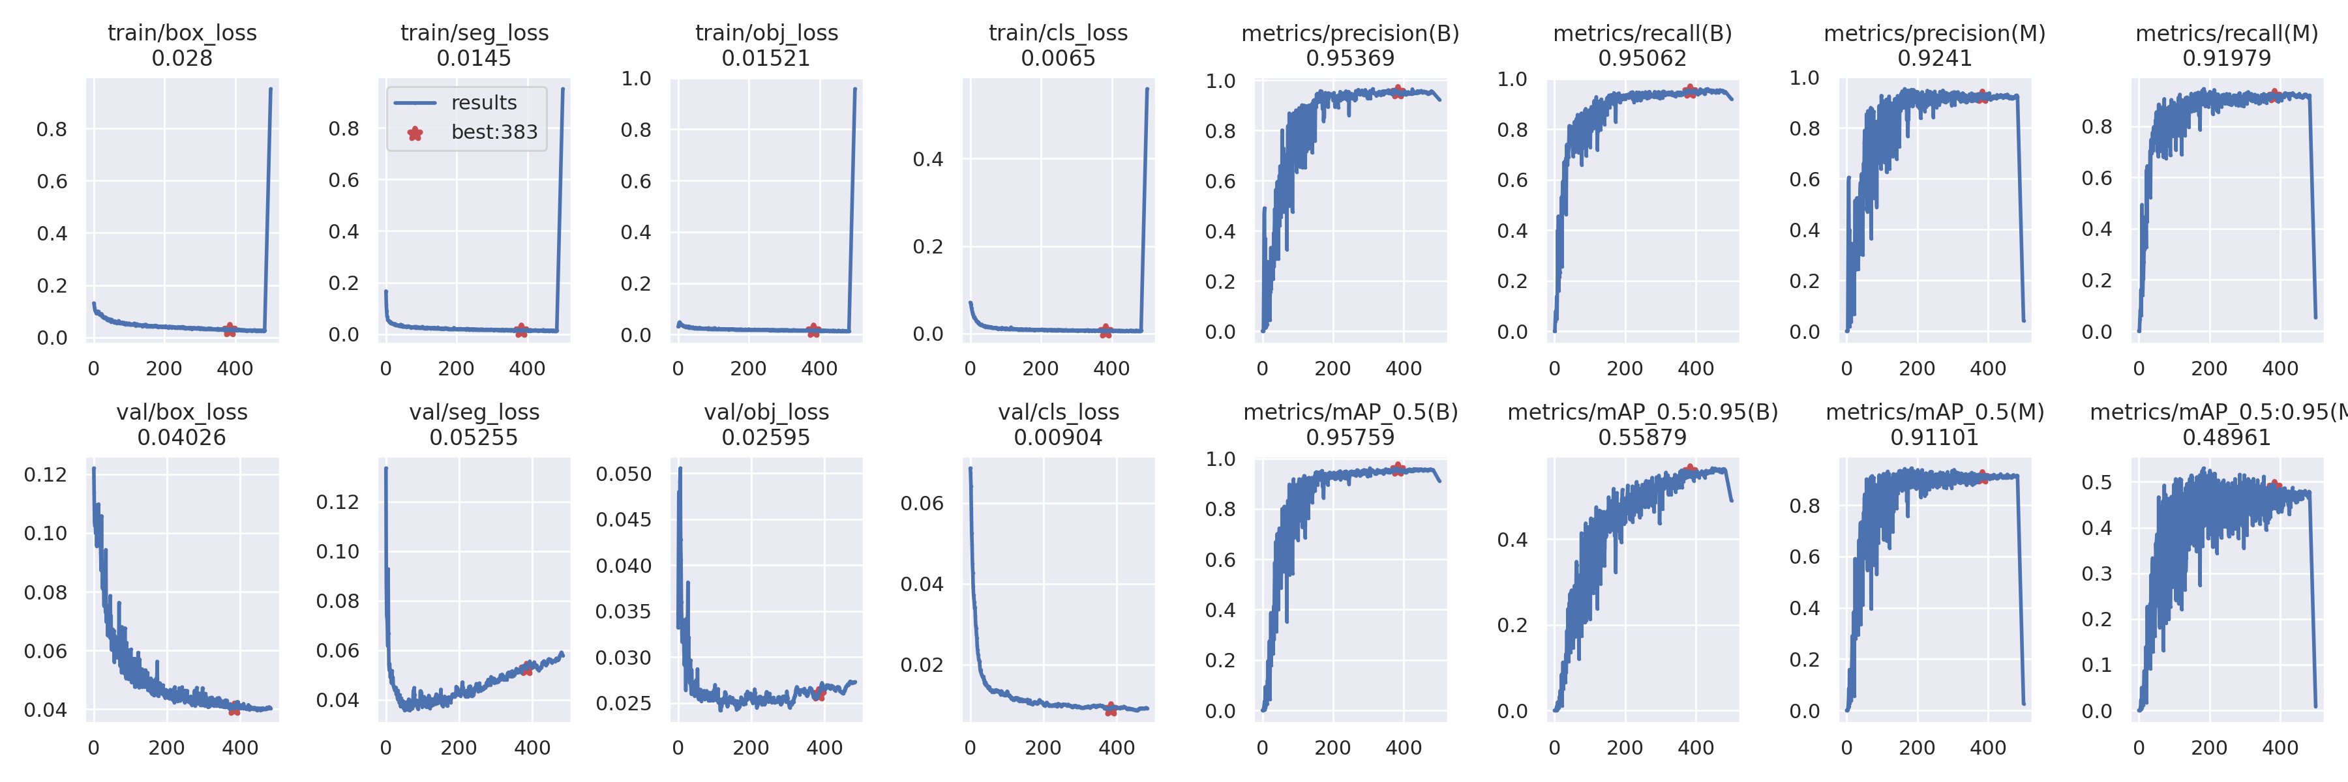
Results

Slide 34
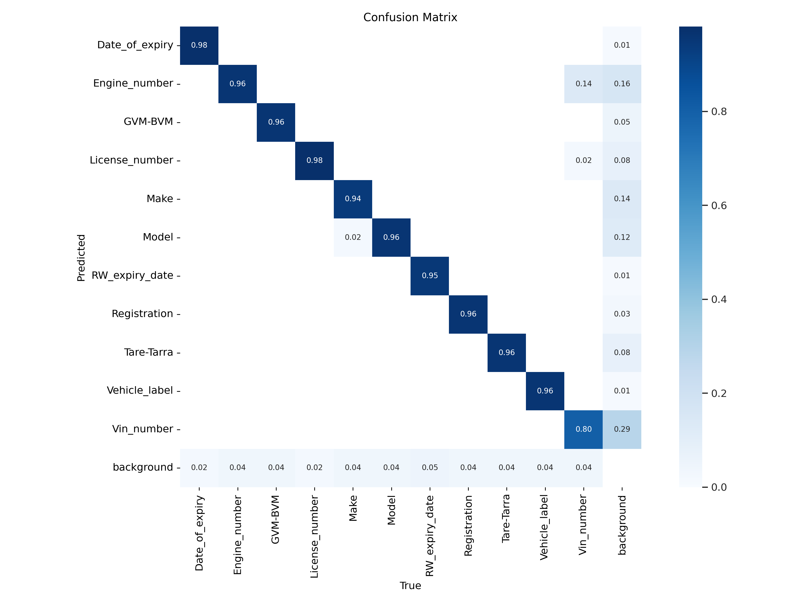
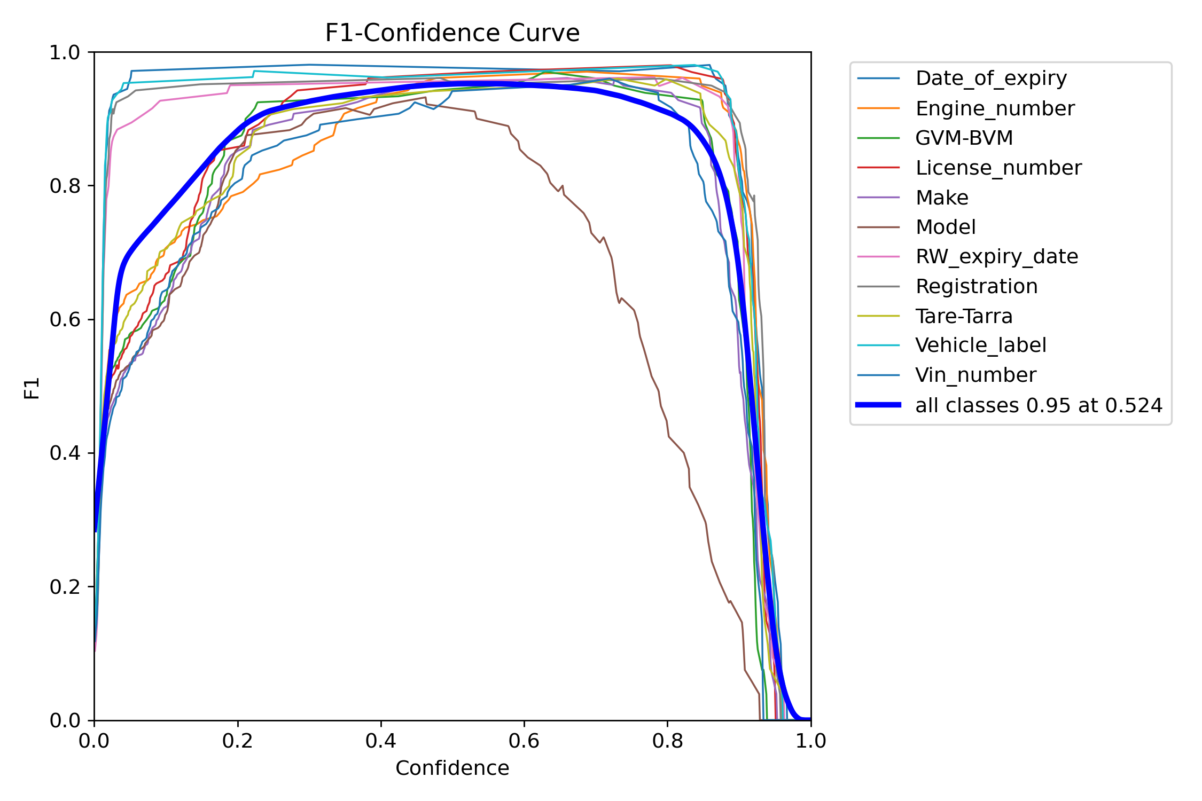
Results

Slide 35

CONCLUSIONS:
Internship at Chaob Technologies (Carscan):
Initially we were uncertain of how stepping into the industry would go but were full of unwavering enthusiasm.
The supportive and welcoming environment made us interns feel comfortable and at home.
Mentorship and guidance from experienced professionals was instrumental in making this internship a great experience.
A look into the workings of an Organisation:
We gained valuable experience interacting with the HR team, Product team and the AI team to gain an insight into the daily functioning of a day in the corporate world.

Slide 36
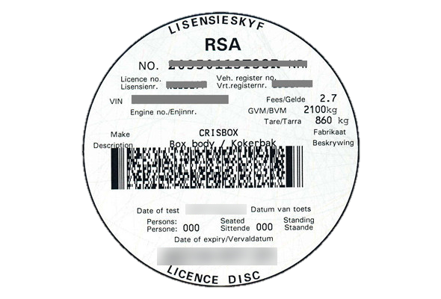
CONCLUSIONS:
Project 1:Dent and Scratch Annotation
Initially, all AI interns worked on Dent and Scratch under Kartik Itharajula on the task of annotation.
As we got better at it, gradually our daily target increased from 25 to 225 images over two months.
Project 2:License Disk Field Detection
Divided into 2 teams, we were mentored by Pushpak Bhoge and Siddhant Jadav in creating our own model.
Regular meetings and online discussions helped us though the various steps.
We created a model that gives highly accurate readings of the various fields on the license disk of South African cars.

Slide 37

CONCLUSIONS:
Valuable Mentorship:
Maintained a daily diary to record experiences and progress.
Mentored by Ranjith Sir and Farhah Masroor from BITS Goa.
Their valuable insights and evaluations guided interns throughout the journey.
Learning and Growth:
Valuable experience teaching teamwork, time management, leadership skills, etc.
Overcoming challenges and obstacles equipped interns with essential skills.
Instilled discipline, structured approach, and improved time management

Slide 38
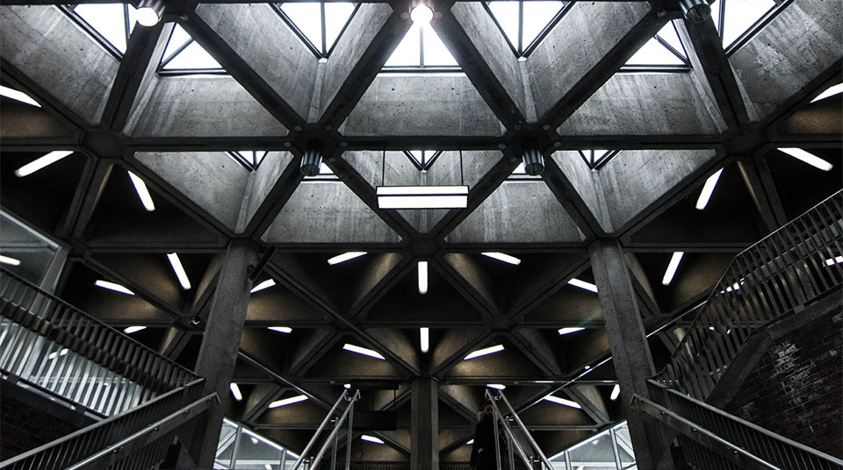
THANK YOU
AI Intern Team

